Slide 1
What is the age distribution of tech workers, and is there evidence of age discrimination in compensation?
By: Darius, Hunter, Kevin, and Amarr

Slide 2

Business Context: Why This Matters
Tech firms depend on a highly skilled workforce which makes compensation and talent pipelines important.
Due to rapid change in technology,, companies often are pushed to prioritize younger workers for speed and adaptability.
This raises concerns about potential age bias in hiring, pay, and promotion.
Organizations with equitable practices gain access to a broader pool of experienced talent, improving innovation and stability.
The research supports leaders in making data-driven decisions about HR policy, hiring, and promotion systems.

Slide 3

Data Overview
Data Source: Survey of full-time U.S. tech employees.
Sample Includes:
  Age group (binned ranges)
  Annual salary (rounded; unrealistic values removed)
  Years of experience (binned)
  Field of work (software engineering, data, support, etc.)
Key Variables:
  Dependent: Salary
  Independent: Age (also controlling for experience)
  Methods: Cleaning, binning, visualizing with Python/pandas/matplotlib.

Slide 4
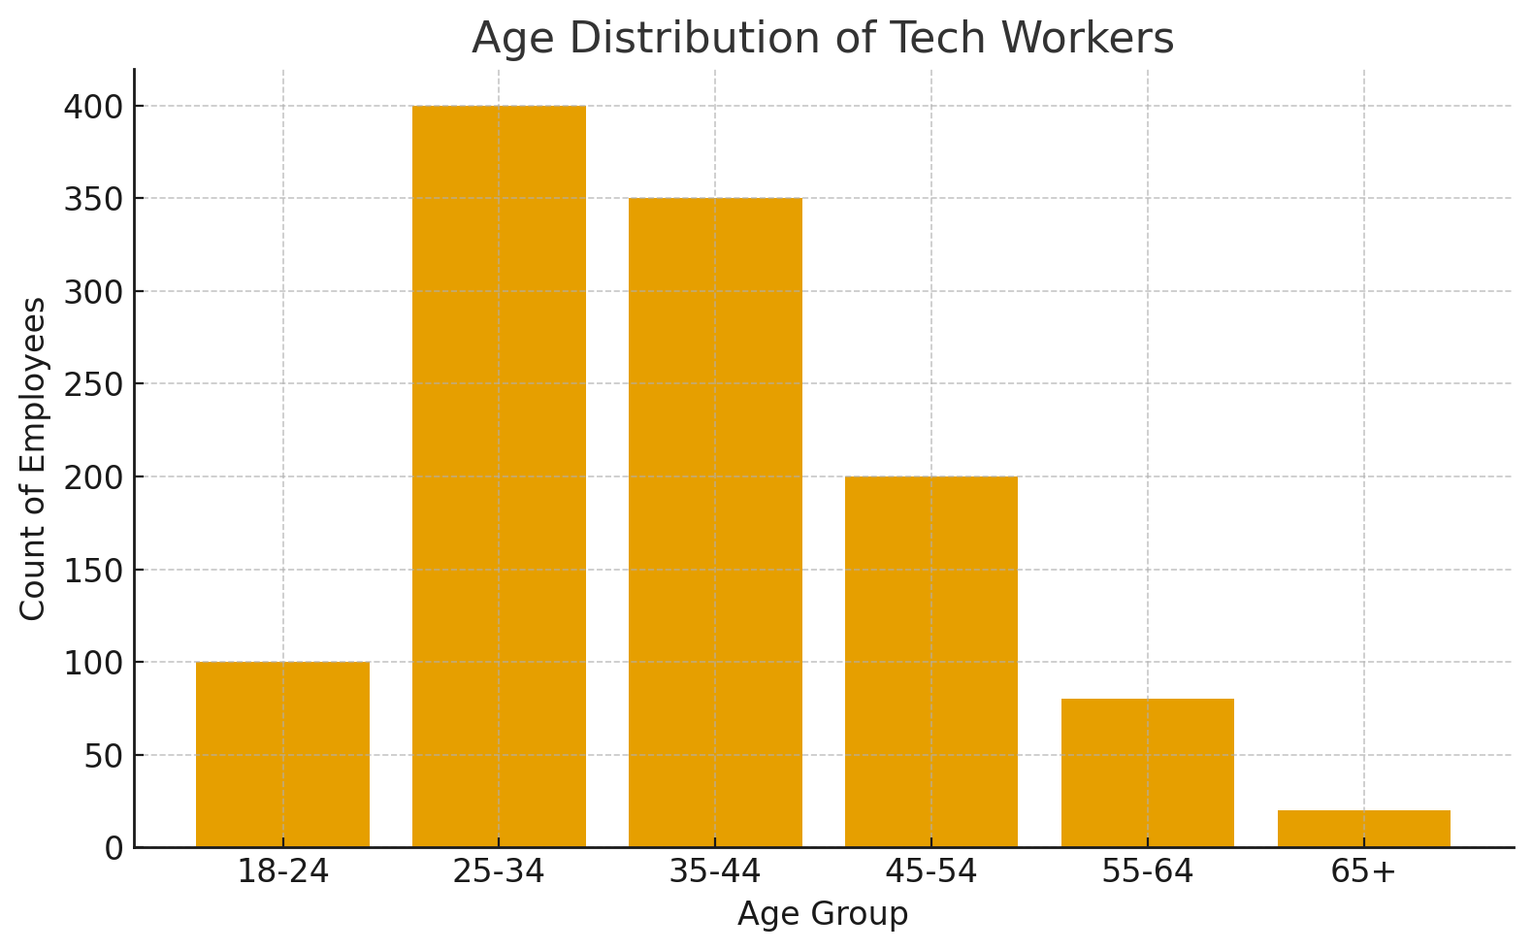
Age Distribution
Tech workforce is heavily concentrated in the 25–34 and 35–44 groups.
Under 25 and 55+ groups are much smaller.
Industry is predominantly under 45.

Slide 5
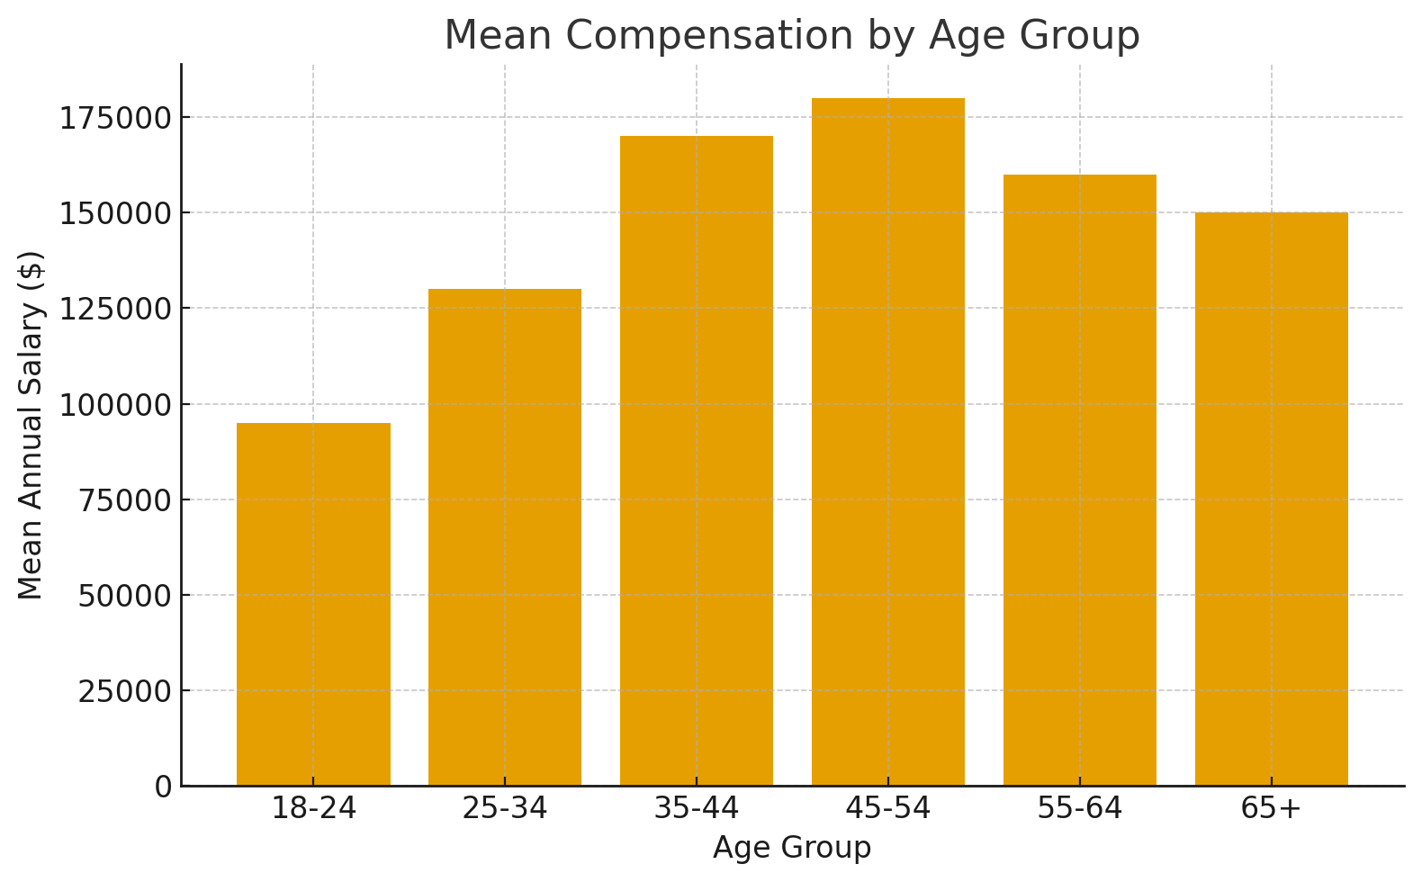
Compensation by Age
45–54 has highest mean salary (~$180k).
35–44 follows closely.
18–24 group has the lowest average salary (~$95k).
Raises questions about the degree to which increases reflect experience vs. structural pay differences.

Slide 6

Statistical Results
Salary increases with age → consistent with experience accumulation.
After controlling for experience:
  Workers 40+ consistently earn more than younger counterparts.
  Gap is widest among less-experienced and mid-career employees.
  Gap narrows only for the most experienced groups.
Indicates age-linked pay disparities not fully explained by experience.

Slide 7
Interpretation
The tech workforce is heavily concentrated with employees under age 45, with very limited representation among workers 55+.
Salary rises with age as expected, but the gaps between younger and mid-career groups are large enough to where experience alone can’t be the only aspect for pay inequity.
Younger workers start with a disadvantage with lower starting salary bands, while the older (experienced) workers may face reduced mobility or bias in hiring.
These patterns suggest that inequities in pay, promotion, and access to higher-level roles based on age are present in the tech community.
Overall, the results show that the tech community is getting younger due to the new innovations and that pay differences are still a problem that has to be addressed by organizations.

Slide 8

Industry Recommendations
Establish salary transparency and disclose ranges.
Conduct annual internal salary reviews with an equity assessment by age.
Investigate employment patterns to determine if an average age difference exists.
Promote advancement criteria related to performance (not age) to distinguish elevated criteria.
Expand hiring practices to older generations to create a more diversified workforce.

Slide 9
Questions ??

